Slide 1

Agriculture

Slide 2

PROBLEM
Problem
Crop failure
COST effective
The risk of losing a crop effort due to adverse climate changes
A cost-effective plan to produce crop has yet to be matured
Crop Yield
The demand for a sustainable food chain supply has been increasing and been a goal of SDG
Energy consumption
Resources such as fertilizer and water must be tracked optimally to ensure the best quality

Slide 3
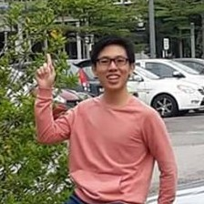
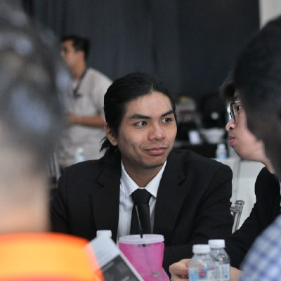
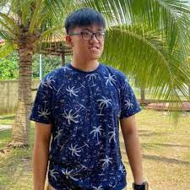
MEET THE TEAM
Tan Jun Wen
Muhammad Suzaril Shah bin Zakaril
Dennis Lau Yik Ann
MMMSA & Software Engineering Student
MLSA & Network Engineer
Software Engineering Student

Slide 4

Weather and My Farm(WAMF)

Slide 5

PRODUCT OVERVIEW
Power platform
Microsoft AI
A low code to no code platform which allows much agile development
Predictive result which ease decision making
Azure Iot hub
Observe crop status by collecting data into Azure IoT hub

Slide 6

SOLUTION
Track farm operation
Event-Driven technology allows better farm state overview on a mobile device
Make better informed decision
Better decision are made over predictive feature
Improve farm productivity
Boost speed of producing higher quality and quantity crop to the market will growing the farm
Economic friendly
Cost effectiveness drives lower price in the market and increase sustainability

Slide 7

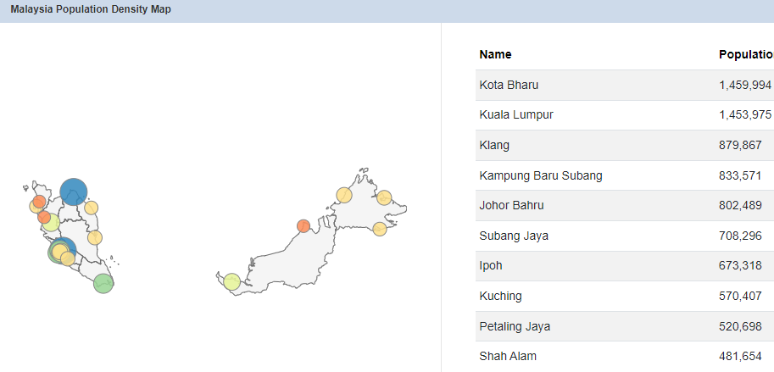
MARKET OVERVIEW
32.94 M
32.94 M
1.87 M
0.30 M
Malaysia Population
(as of 10/31/2021, from worldpopulationreview.com)
People enrolled in the agriculture industry
(from statista.com)
Paddy farmers in Malaysia
(from socioeconomic malaysia)

Slide 8

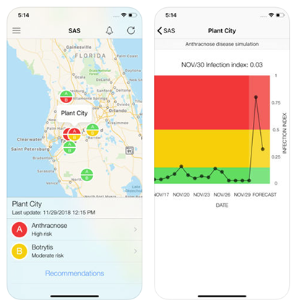
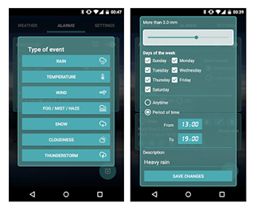
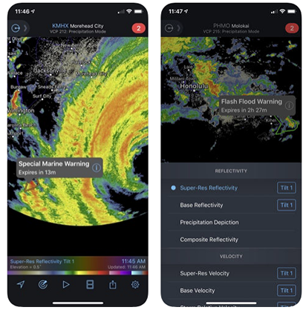
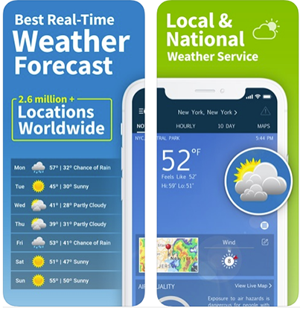
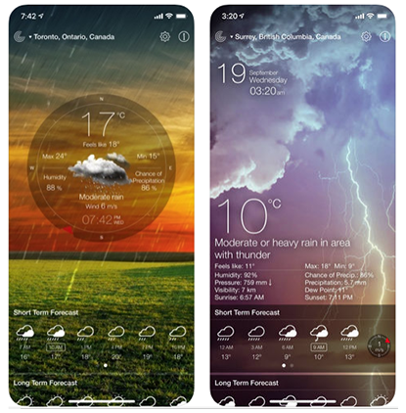
MARKET COMPARISON
Competitors |  | Free | Available in Malaysia | Contains Ads | Available in Android | Available in iOS | Advisory Service
WAMF (Proposed) |  | Y | Y | Y | Y | Y | Y
Strawberry Advisory System |  | Y | Y | Y | Y | Y
Custom Weather Alerts |  | Y |  | Y | Y | Y
RadarScope |  |  |  |  | Y | Y
WeatherBug |  | Y |  | Y | Y | Y
Weather Live |  | Y |  | Y | Y | Y
$3B
$2B
$1B
Opportunity to build
Addressable market
Freedom to invent
Serviceable market
Few competitors
Obtainable market

Slide 9

Thank You
Tan Jun Wen
+6011 3666 2925
Jwtan-wm19@student.tarc.edu.my

Slide 10

ABOUT US
About
At Contoso, we empower businesses to foster collaborative thinking to further drive workplace innovation. By closing the loop on investment management and using the latest technology, we help businesses grow and expand their portfolio funds.

Slide 11

PRODUCT BENEFITS
Simple and efficient to use
Quick customer service assistance
Free 90-day investment help for new customers
Benefits

Slide 12

BUSINESS MODEL
RESEARCH
ABSTRACT
DESIGN
We based our research on market trends and stock market historical performance data
We believe people need new investment tools to help businesses grow their funds
Minimalist design and easy to use

Slide 13

OUR COMPETITION
CONTOSO
COMPETITORS
Our product is priced below that of other financial management tools on the market
Simple and easy to use app and website, compared to the complex tools of the competitors
Affordability is the main draw for our consumers to our product
Company A Product is more expensive
Companies B & C Product is expensive and inconvenient to use
Companies D & E Product is affordable, but inconvenient to use

Slide 14

GROWTH STRATEGY
How we’ll scale in the future
FEB 20XX
MAY 20XX
OCT 20XX
Roll out product to local businesses to help establish the product
Release the product to the general public and monitor stock market trends
Gather feedback from the financial community to expand availability of the product

Slide 15
OUR COMPETITION
Convenient
CONTOSO
A
Expensive
Affordable
D
C
E
B
Inconvenient

Slide 16
TRACTION
Forecasting for success
Key metrics
Revenue by year
 | Clients | Orders | Gross revenue | Net revenue
20XX | 10 | 1100 | $10,000 | $7,000
20XX | 20 | 200 | $20,000 | $16,000
20XX | 30 | 300 | $30,000 | $25,000
20XX | 40 | 400 | $40,000 | $30,000

Slide 17
TWO-YEAR ACTION PLAN
Supply volunteers
Run focus groups
Gather feedback
Feb 20XX
May 20XX
Oct 20XX
20XX
JAN
FEB
MAR
APR
MAY
JUN
JUL
AUG
SEP
OCT
NOV
DEC
20XX
JAN
FEB
MAR
APR
MAY
JUN
JUL
AUG
SEP
OCT
NOV
DEC
Test with businesses
Regional launch
Deliver to consumers
Feb 20XX
July 20XX
Dec 20XX

Slide 18
FINANCIALS
 | Year 1 | Year 2 | Year 3 | Percent of Total
Income
Users | 50,000 | 400,000 | 1,600,000
Sales | 500,000 | 4,000,000 | 16,000,000
Average price per sale | 75 | 80 | 90
Revenue @ 15% | 5,625,000 | 48,000,000 | 216,000,000
Gross profit | 5,625,000 | 48,000,000 | 216,000,000
Expenses
Sales & marketing | 5,062,500 | 38,400,000 | 151,200,000 | 70%
Customer service | 1,687,500 | 9,600,000 | 21,600,000 | 10%
Product development | 562,500 | 2,400,000 | 10,800,000 | 5%
Research | 281,250 | 2,400,000 | 4,320,000 | 2%
Total expenses | 7,593,750 | 52,800,000 | 187,920,000

Slide 19
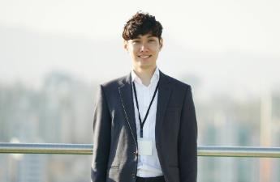







MEET THE FULL TEAM
Takuma Hayashi
Mirjam Nilsson
Flora Berggren
Rajesh Santoshi
President
Chief Executive Officer
Chief Operations Officer
VP Marketing
Graham Barnes
Rowan Murphy
Elizabeth Moore
Robin Kline
VP Product
SEO Strategist
Product Designer
Content Developer

Slide 20
FUNDING
MUTUAL FUNDS
ANGEL INVESTMENTS
CASH
SHARES
$12,000
$14,000
$32,000
$82,000
Revenue obtained from blue chip mutual funds
Amount obtained through other investors
Liquid cash we have on hand
Number of shares converted into USD

Slide 21

SUMMARY
At Contoso, we believe in giving 110%. By closing the loop on investment management and using the latest technology, we help businesses grow and expand their portfolio funds. We thrive because of our market knowledge and a great team behind our product. As our CEO says, "Efficiencies will come from proactively transforming how we do business."
summary

